Slide 1
Kaiser Permanente – ML/AI COE
December 18th 2019

Slide 2

Agenda
01
Lambda architecture - overview
02
Patterns & Principles of Lambda architecture
03
Azure Lambda architecture
04
Azure Lambda architecture with Change Feed
05
Potential use case in Healthcare
06
Key takeaways
07
Appendix

Slide 3
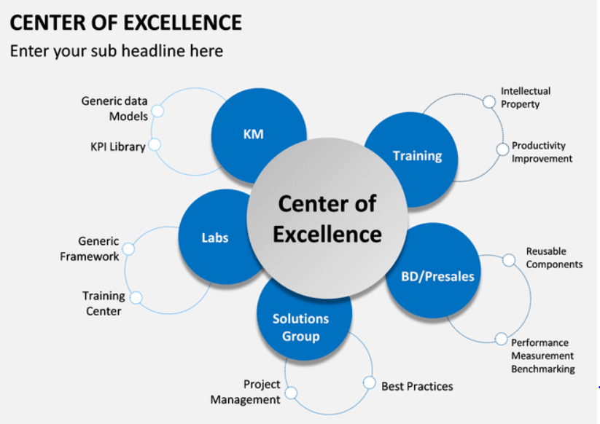

Slide 4
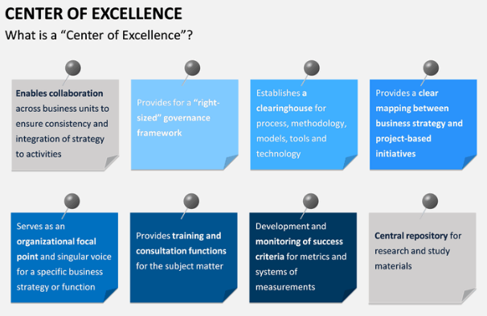

Slide 5
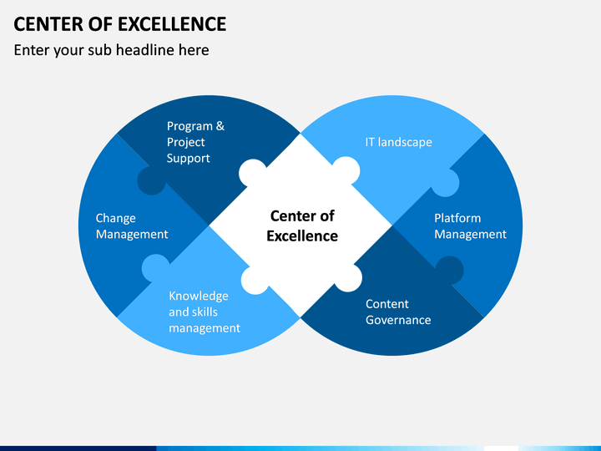

Slide 6
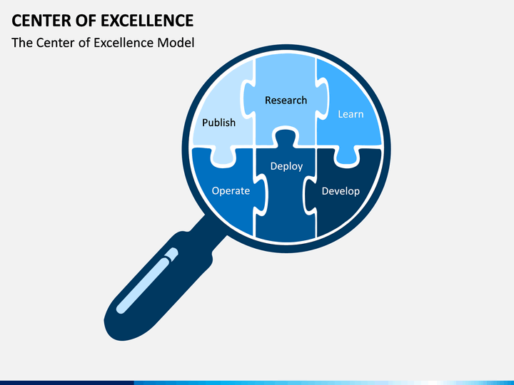

Slide 7
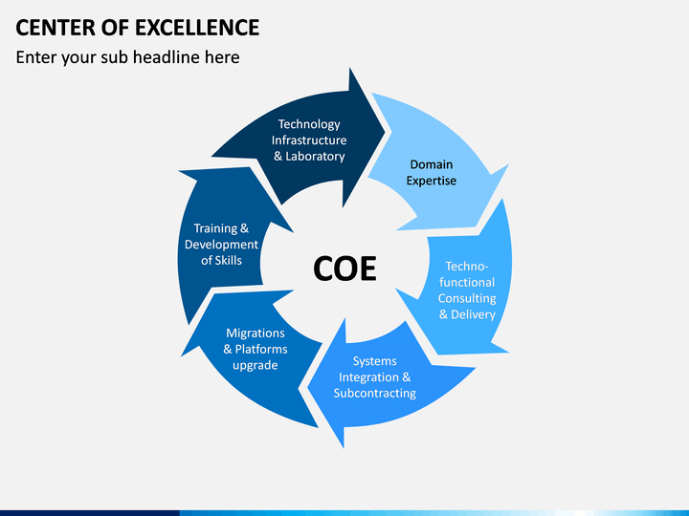

Slide 8
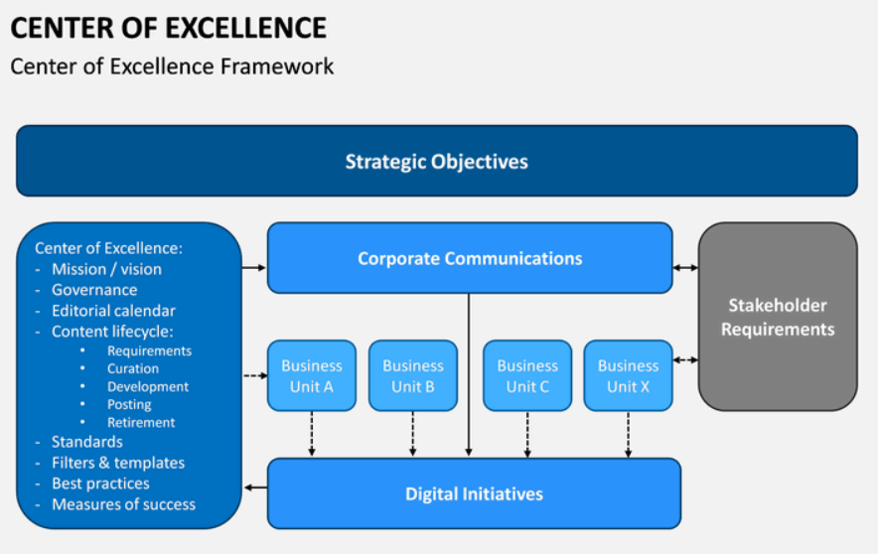

Slide 9
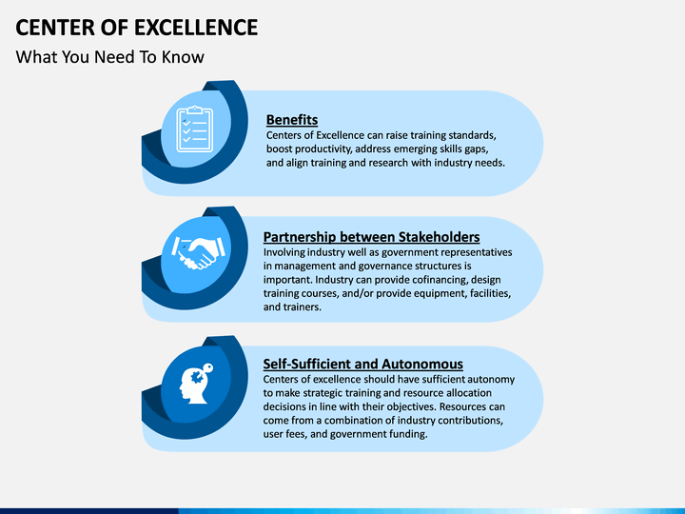

Slide 10
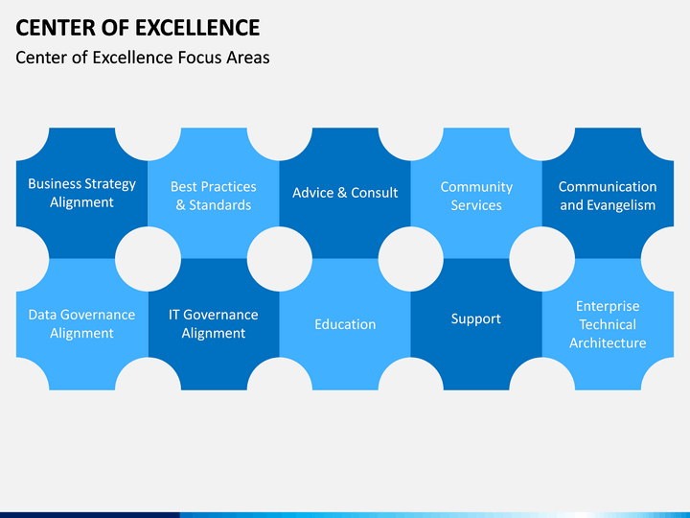

Slide 11
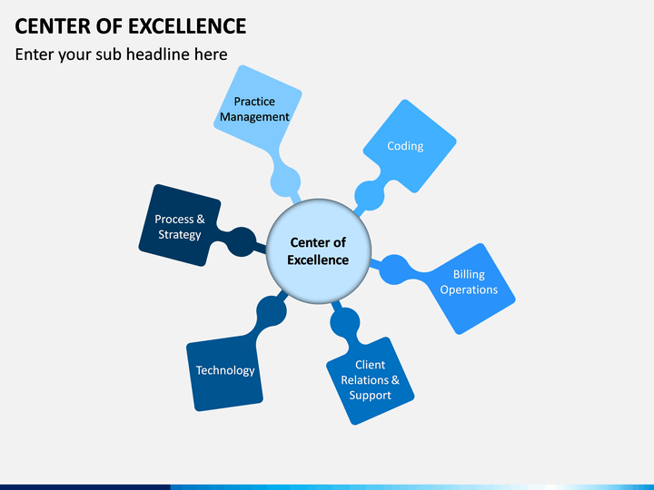

Slide 12
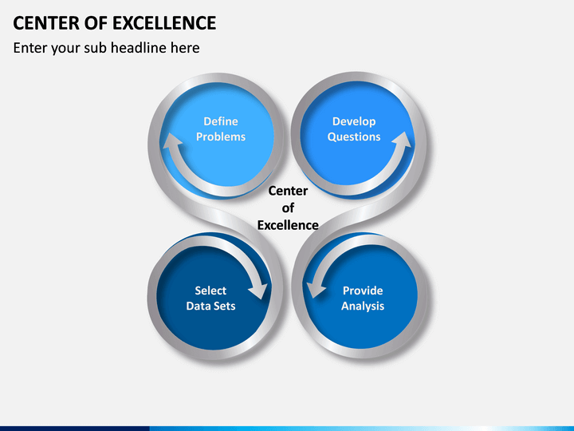

Slide 13
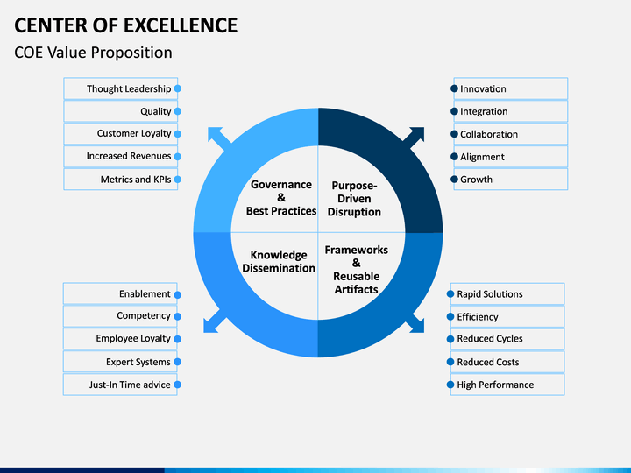

Slide 14
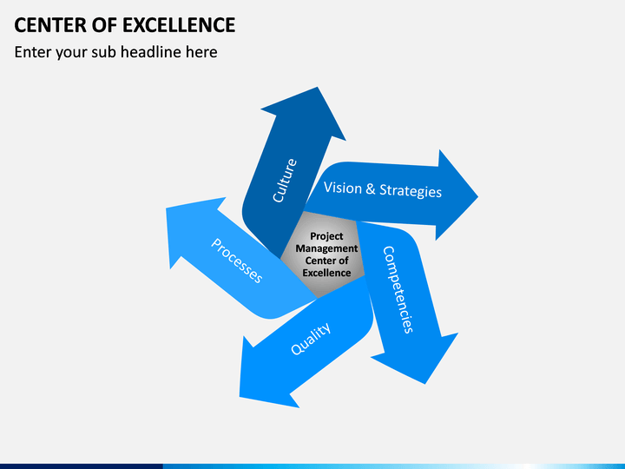

Slide 15
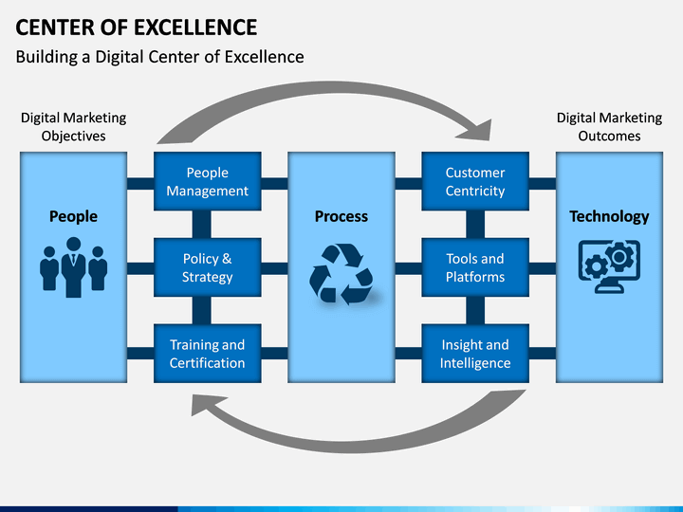

Slide 16
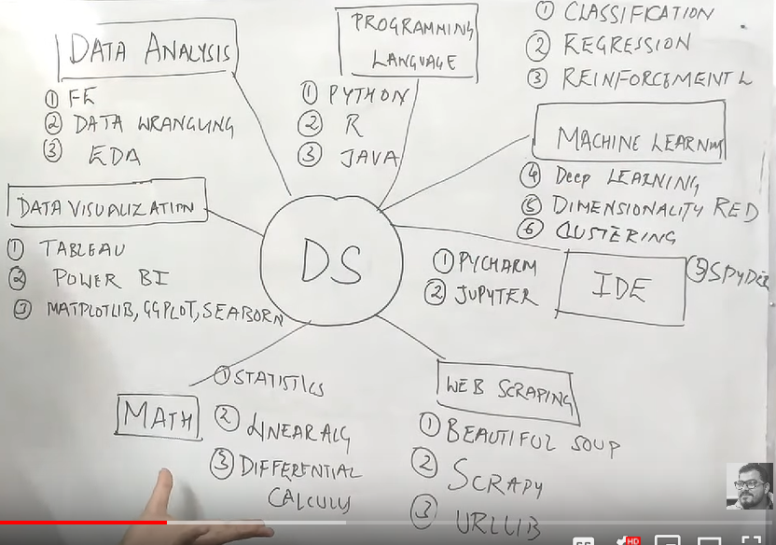

Slide 17
Data Science
Feature Engineering
Data Wrangling
Exploratory Data Analysis
Data Analysis
Tools, e.g., DataRobot, Flask,…
Runbooks
Languages
Deployment modes
Deployment
Python
R
Java
Programming Language
Power BI
Tableau
Matplotlib, Ggplot, Seaborn
Data Science
Data Visualization
Visual Studio Code
PycCharm
Jupyter
Spyder
IDE
Statistics
Linearity
Differential Calculus
Classification
Regression
Re-enforcement
Deep Learning
Dimensionality Reduction
Clustering
Web Scraping – to get test data:
Beautiful Soup
Scrapy
Re-enforcement
Urllib
Math
Machine Learning

